Slide 1
Vanadium Oxide on Anatase (101)

Slide 2
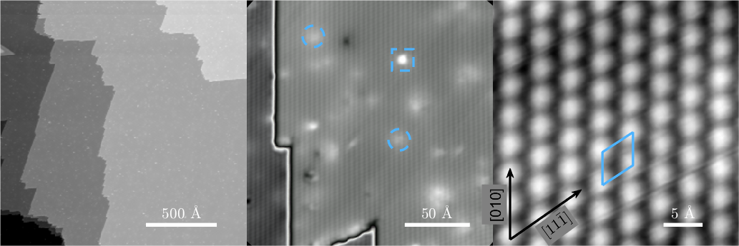
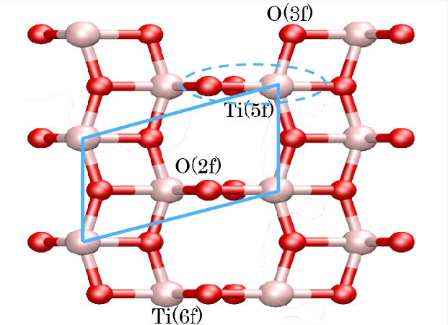
Clean anatase Tio2 (101)

Slide 3
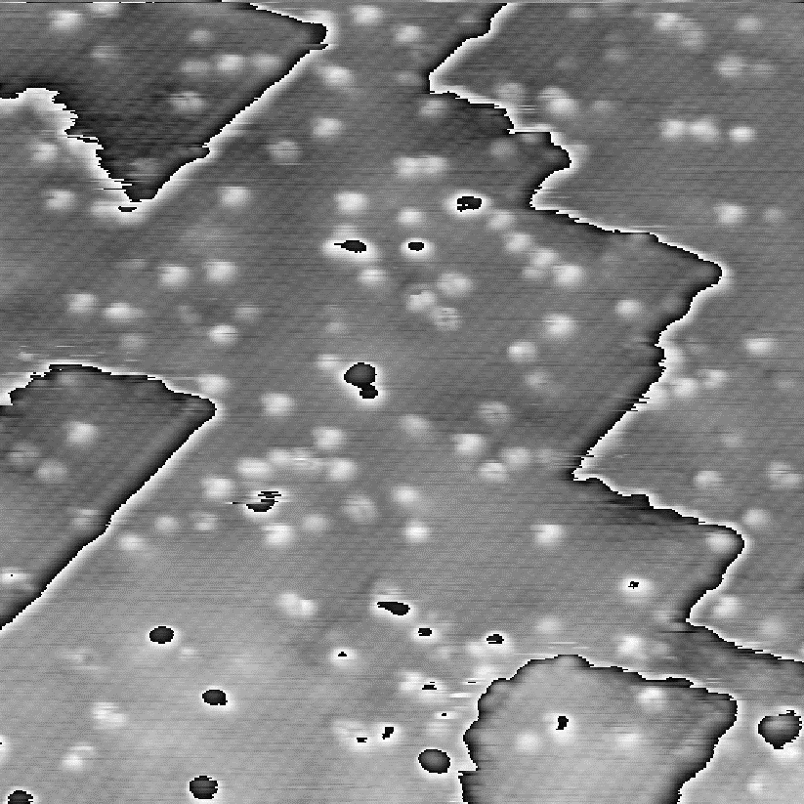
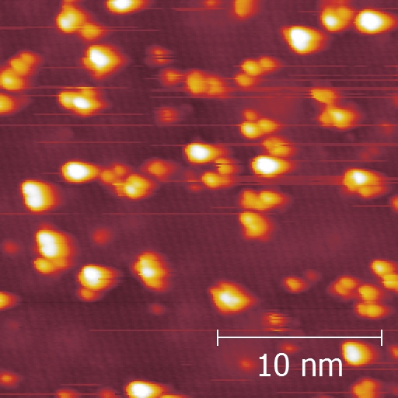
STM of V2O5 –clusters (as-deposited)
V2O5 clusters on a-TiO2
– evaporated from metal in O2
V2O5 clusters on a-TiO2
– evaporated from powder

Slide 4
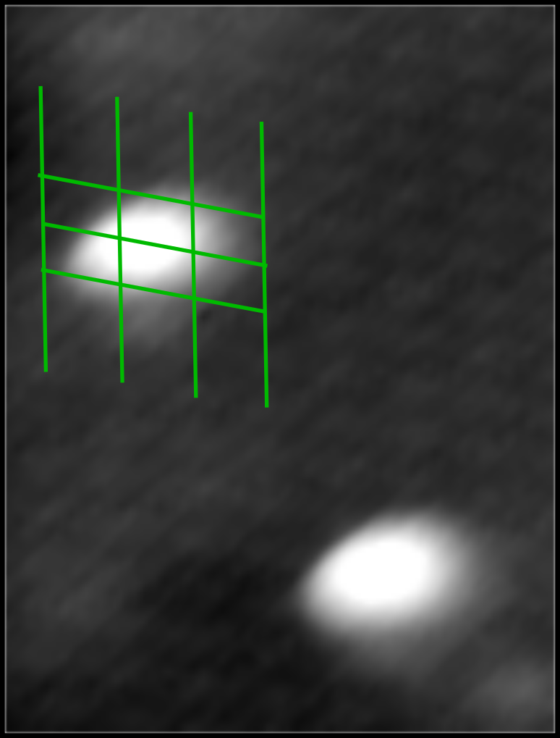
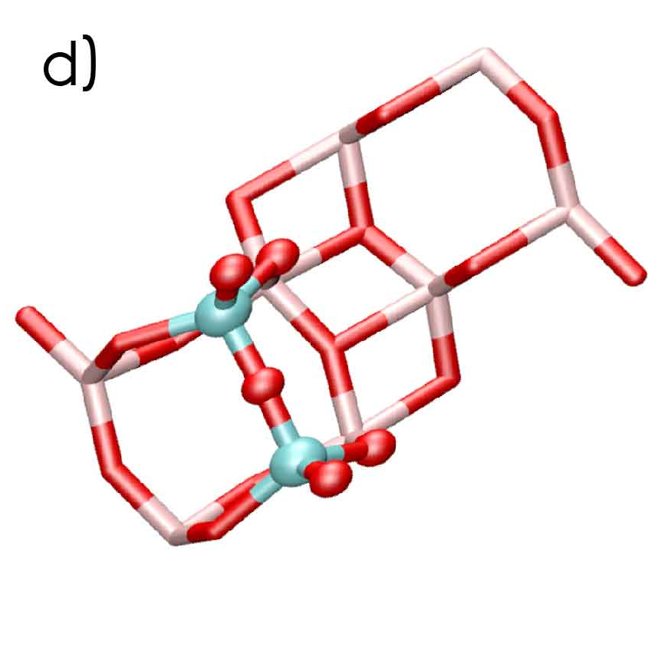
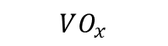
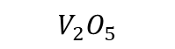
Structural models
$$VO_{x}$$
$$V_{2}O_{5}$$

Slide 5
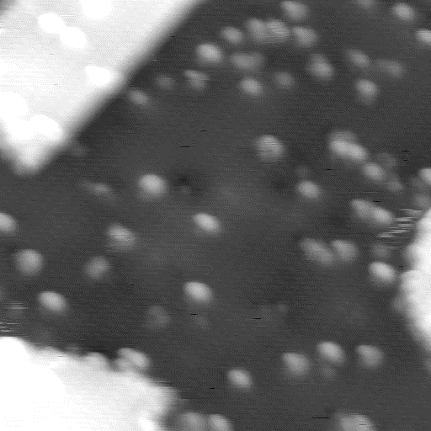
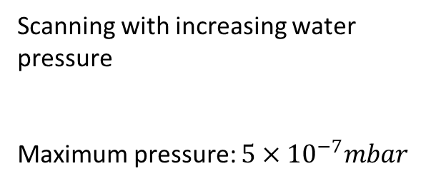
Adding water
Scanning with increasing water pressure
Maximum pressure: $5×{10}^{−7}mbar$

Slide 6
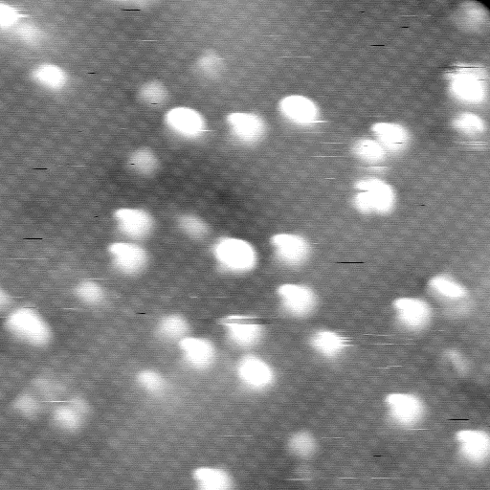
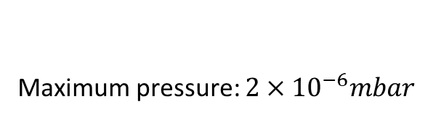
Re-exposing
Maximum pressure: $2×{10}^{−6}mbar$

Slide 7
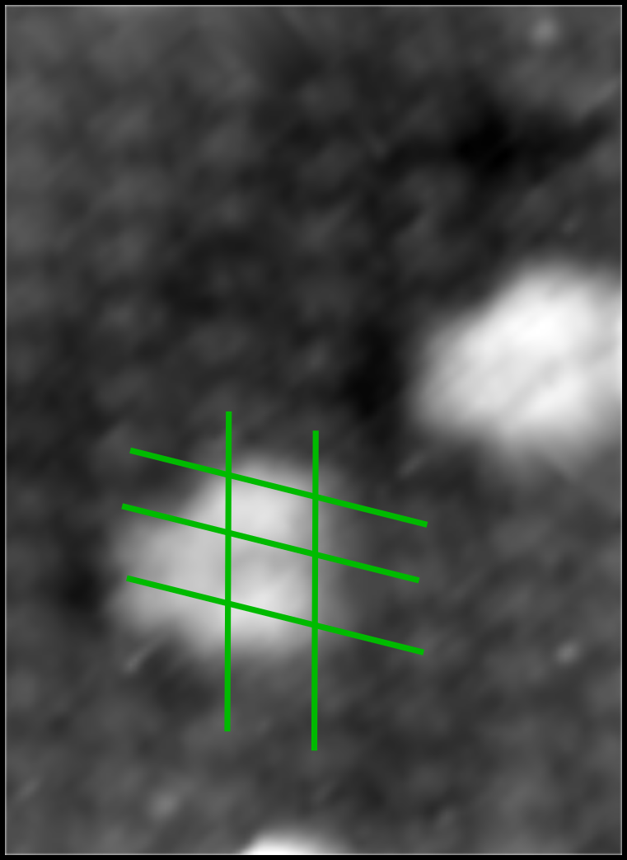
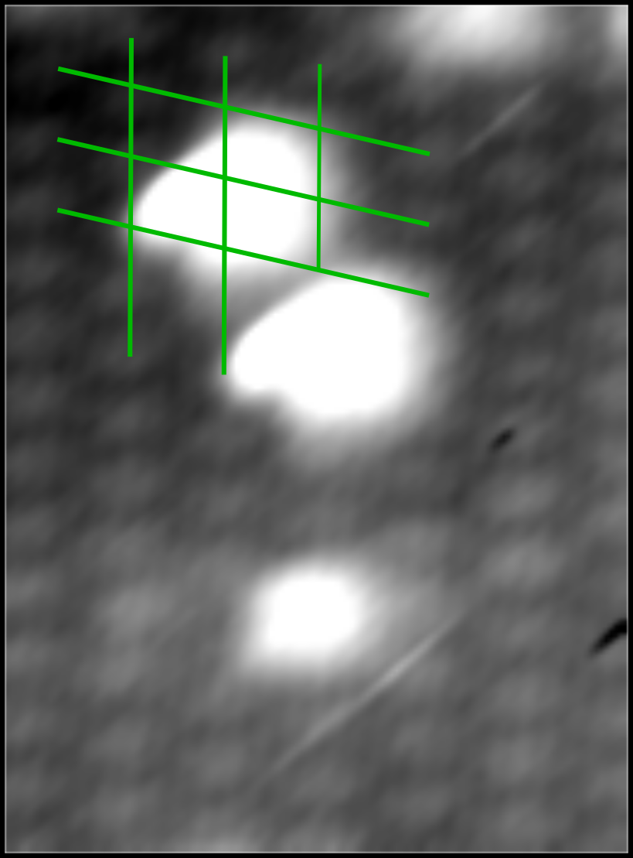
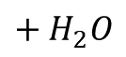
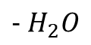
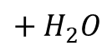
3 features are present during the experiment
Across the rows
Before water exposure
Cherry
During water exposure
Nose
After water exposure
$$+ H_{2}O$$
$$− H_{2}O$$
$$+ H_{2}O$$

Slide 8
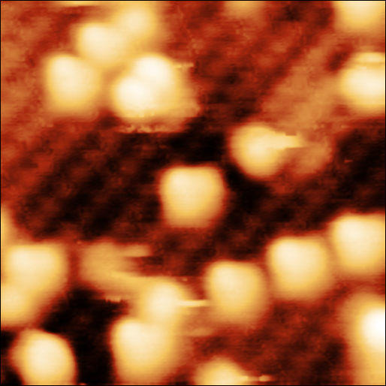
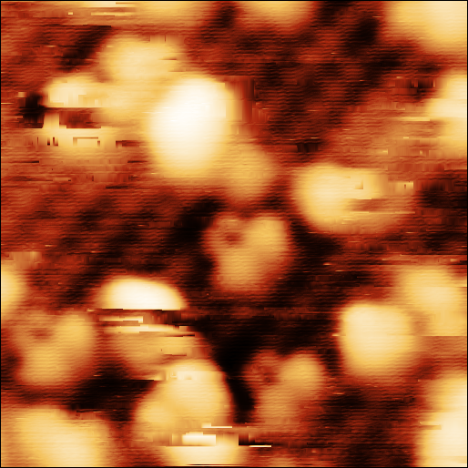
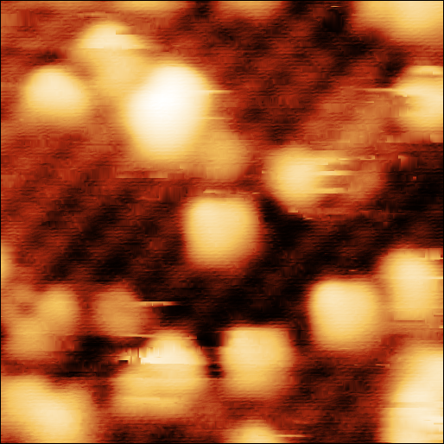
Another re-exposure
Across the rows
Before water exposure
Cherry
During water exposure
Nose
After water exposure

Slide 9
Planned experiments
- Higher coverages and slight annealing maybe during water exposure
- measure the amount of different species as function of H2O pressure.
- Low temp. water exposure
- Ammonia interaction
- eventually NO interaction

Slide 10
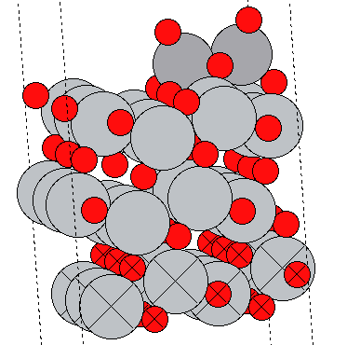
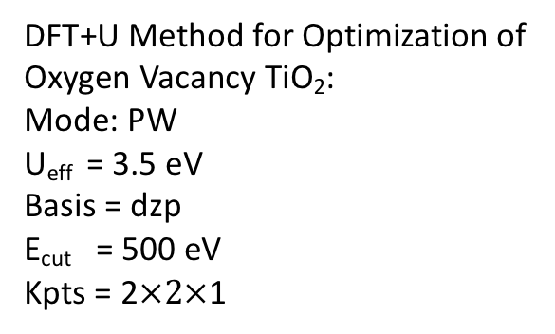
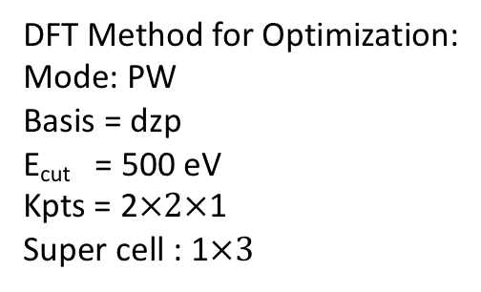
Anatase TiO₂ (101) surface and O vacancy Anatase TiO₂ (101) surface
DFT Method for Optimization:
Mode: PW
Basis = dzp
E_{cut} = 500 eV
Kpts = 2$×2×$1
Super cell : 1$×3$
DFT+U Method for Optimization of
Oxygen Vacancy TiO₂:
Mode: PW
U_{eff} = 3.5 eV
Basis = dzp
E_{cut} = 500 eV
Kpts = 2$×2×$1

Slide 11
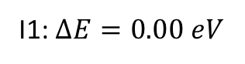
VO₂ Cluster
I1: $∆E=0.00 eV$
VO₂

Slide 12
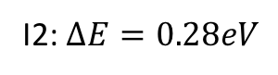
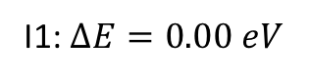
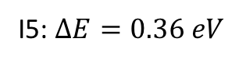
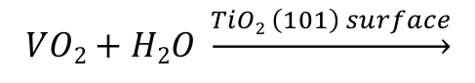
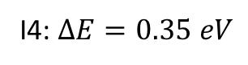
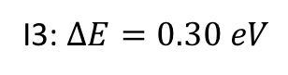
Hydroxylation of VO₂ Clusters
$$VO2+H2O \underset{→}{TiO2 \left(101\right) surface}$$
I1: $∆E=0.00 eV$
I2: $∆E=0.28eV$
I3: $∆E=0.30 eV$
I4: $∆E=0.35 eV$
I5: $∆E=0.36 eV$

Slide 13
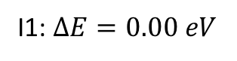
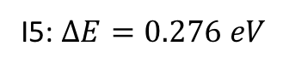
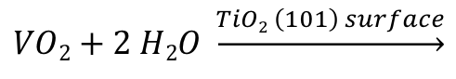
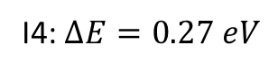
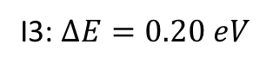
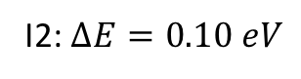
Hydroxylation of VO₂ Clusters
$$VO2+2 H2O \underset{→}{TiO2 \left(101\right) surface}$$
I1: $∆E=0.00 eV$
I2: $∆E=0.10 eV$
I3: $∆E=0.20 eV$
I4: $∆E=0.27 eV$
I5: $∆E=0.276 eV$

Slide 14
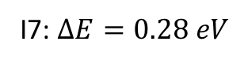
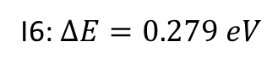
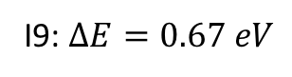
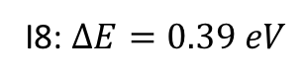
Hydroxylation of VO₂ Clusters
$$VO2+2 H2O \underset{→}{TiO2 \left(101\right) surface}$$
I6: $∆E=0.279 eV$
I7: $∆E=0.28 eV$
I8: $∆E=0.39 eV$
I9: $∆E=0.67 eV$

Slide 15
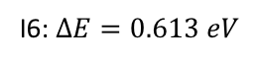
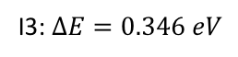
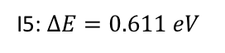
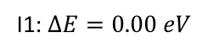
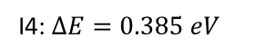
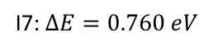
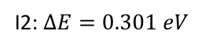
V₂O₄ Clusters
I1: $∆E=0.00 eV$
I2: $∆E=0.301 eV$
I3: $∆E=0.346 eV$
I4: $∆E=0.385 eV$
I5: $∆E=0.611 eV$
I6: $∆E=0.613 eV$
I7: $∆E=0.760 eV$

Slide 16
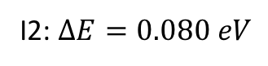
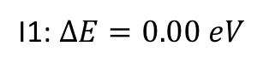
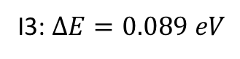




Hydroxylation of V₂O₄ Clusters
$$V2O4+H2O \underset{→}{TiO2 \left(101\right) surface}$$
I1: $∆E=0.00 eV$
I2: $∆E=0.080 eV$
I3: $∆E=0.089 eV$
I4: $∆E=0.128 eV$
I5: $∆E=0.350 eV$
I6: $∆E=0.441 eV$

Slide 17





Hydroxylation of V₂O₄ Clusters
$$V2O4+H2O \underset{→}{TiO2 \left(101\right) surface}$$
I7: $∆E=0.566 eV$
I8: $∆E=0.581 eV$
I9: $∆E=0.592 eV$
I10: $∆E=0.634 eV$
I11: $∆E=0.644 eV$

Slide 18





Hydroxylation of V₂O₄ Clusters
$$V2O4+2 H2O \underset{→}{TiO2 \left(101\right) surface}$$
I1: $∆E=0.00 eV$
I2: $∆E=0.083 eV$
I3: $∆E=0.332 eV$
I4: $∆E=0.366 eV$

Slide 19



Hydroxylation of V₂O₄ Clusters
$$V2O4+2 H2O \underset{→}{TiO2 \left(101\right) surface}$$
I5: $∆E=0.433 eV$
I6: $∆E=0.434 eV$
I7: $∆E=0.532 eV$

Slide 20







V₂O₅ Clusters on TiO₂ (1$×3$ supercell)
I1: $∆E=0.00 eV$
I2: $∆E=0.22 eV$
I3: $∆E=0.35 eV$
I4: $∆E=0.38 eV$
I5: $∆E=0.58 eV$
I6: $∆E=1.12 eV$

Slide 21






Hydroxylation of V₂O₅ Clusters
$$V2O5+ H2O \underset{→}{TiO2 \left(101\right) surface}$$
I1: $∆E=0.00 eV$
I2: $∆E=0.068 eV$
I3: $∆E=0.095 eV$
I4: $∆E=0.122 eV$
I5: $∆E=0.138 eV$

Slide 22




Hydroxylation of V₂O₅ Clusters
$$V2O5+ H2O \underset{→}{TiO2 \left(101\right) surface}$$
I6: $∆E=0.175 eV$
I7: $∆E=0.221 eV$
I8: $∆E=0.223 eV$
I9: $∆E=0.224 eV$

Slide 23





Hydroxylation of V₂O₅ Clusters
$$V2O5+ H2O \underset{→}{TiO2 \left(101\right) surface}$$
I10: $∆E=0.263 eV$
I11: $∆E=0.331 eV$
I12: $∆E=0.350 eV$
I13: $∆E=0.390 eV$
I14: $∆E=0.407 eV$

Slide 24





Hydroxylation of V₂O₅ Clusters
$$V2O5+ H2O \underset{→}{TiO2 \left(101\right) surface}$$
I15: $∆E=0.411 eV$
I16: $∆E=0.413 eV$
I17: $∆E=0.421 eV$
I18: $∆E=0.443 eV$
I19: $∆E=0.465 eV$

Slide 25





Hydroxylation of V₂O₅ Clusters
$$V2O5+ H2O \underset{→}{TiO2 \left(101\right) surface}$$
I20: $∆E=0.473 eV$
I21: $∆E=0.498 eV$
I22: $∆E=0.634 eV$
I23: $∆E=0.734 eV$
I24: $∆E=0.786 eV$

Slide 26





Hydroxylation of V₂O₅ Clusters
$$V2O5+ H2O \underset{→}{TiO2 \left(101\right) surface}$$
I25: $∆E=0.803 eV$
I26: $∆E=0.816 eV$
I27: $∆E=0.861 eV$
I28: $∆E=1.138 eV$
I29: $∆E=1.518 eV$

Slide 27







Hydroxylation of V₂O₅ Clusters
$$V2O5+2 H2O \underset{→}{TiO2 \left(101\right) surface}$$
I1: $∆E=0.00 eV$
I2: $∆E=0.022 eV$
I3: $∆E=0.031 eV$
I4: $∆E=0.055 eV$
I5: $∆E=0.097 eV$
I6: $∆E=0.101 eV$

Slide 28






Hydroxylation of V₂O₅ Clusters
$$V2O5+2 H2O \underset{→}{TiO2 \left(101\right) surface}$$
I7: $∆E=0.118 eV$
I8: $∆E=0.121 eV$
I9: $∆E=0.176 eV$
I10: $∆E=0.227 eV$
I11: $∆E=0.265 eV$
I12: $∆E=0.293 eV$

Slide 29






Hydroxylation of V₂O₅ Clusters
$$V2O5+2 H2O \underset{→}{TiO2 \left(101\right) surface}$$
I13: $∆E=0.298 eV$
I14: $∆E=0.321 eV$
I15: $∆E=0.355 eV$
I16: $∆E=0.375 eV$
I17: $∆E=0.383 eV$
I18: $∆E=0.401 eV$

Slide 30






Hydroxylation of V₂O₅ Clusters
$$V2O5+2 H2O \underset{→}{TiO2 \left(101\right) surface}$$
I19: $∆E=0.406 eV$
I20: $∆E=0.422 eV$
I21: $∆E=0.448 eV$
I22: $∆E=0.502 eV$
I23: $∆E=0.529 eV$
I24: $∆E=0.676 eV$

Slide 31




Hydroxylation of V₂O₅ Clusters
$$V2O5+2 H2O \underset{→}{TiO2 \left(101\right) surface}$$
I25: $∆E=0.719 eV$
I26: $∆E=0.954 eV$
I27: $∆E=1.032 eV$
I28: $∆E=1.173 eV$

Slide 32







V₂O₅ Clusters on TiO₂ (1$×4$ supercell)
I1: $∆E=0.00 eV$
I2: $∆E=0.174 eV$
I3: $∆E=0.231 eV$
I4: $∆E=0.254 eV$
I5: $∆E=0.352 eV$
I6: $∆E=0.367 eV$

Slide 33





V₂O₅ Clusters on TiO₂ (1$×4$ supercell)
I7: $∆E=0.616 eV$
I8: $∆E=0.895 eV$
I9: $∆E=1.139 eV$
I10: $∆E=1.197 eV$
I11: $∆E=1.211 eV$

Slide 34




V₂O₅ Clusters on TiO₂ (1$×4$ supercell)
I12: $∆E=1.237 eV$
I13: $∆E=1.278 eV$
I14: $∆E=1.74 eV$
I15: $∆E=2.07 eV$

Slide 35













V₂O₅ Clusters on TiO₂ (1$×4$ supercell) Complete slab relax
I1: $∆E=0.00 eV$
I2: $∆E=0.236 eV$
I3: $∆E=0.251 eV$
I4: $∆E=0.265 eV$
I5: $∆E=0.296 eV$
I6: $∆E=0.305 eV$

Slide 36







(V₂O₅ + H2O) Clusters on TiO₂ (1$×4$ supercell)
$$V2O5+ H2O \underset{→}{TiO2 \left(101\right) surface}$$
I1: $∆E=0.000 eV$
I2: $∆E=0.031 eV$
I3: $∆E=0.079 eV$
I4: $∆E=0.094 eV$
I5: $∆E=0.121 eV$

Slide 37







(V₂O₅ + H2O) Clusters on TiO₂ (1$×4$ supercell)
$$V2O5+ H2O \underset{→}{TiO2 \left(101\right) surface}$$
I6: $∆E=0.141 eV$
I7: $∆E=0.144 eV$
I8: $∆E=0.189 eV$
I9: $∆E=0.262 eV$
I10: $∆E=0.273 eV$

Slide 38





(V₂O₅ + H2O) Clusters on TiO₂ (1$×4$ supercell)
$$V2O5+ H2O \underset{→}{TiO2 \left(101\right) surface}$$
I11: $∆E=0.321 eV$
I12: $∆E=0.324 eV$
I13: $∆E=0.334 eV$
I14: $∆E=0.340 eV$
I15: $∆E=0.342 eV$

Slide 39




(V₂O₅ + H2O) Clusters on TiO₂ (1$×4$ supercell)
$$V2O5+ H2O \underset{→}{TiO2 \left(101\right) surface}$$
I16: $∆E=0.353 eV$
I17: $∆E=0.410 eV$
I18: $∆E=0.622 eV$
I19: $∆E=0.703 eV$

Slide 40














(V₂O₅ + H2O) Clusters on TiO₂ (1$×4$ supercell) Complete Slab Relax
$$V2O5+H2O \underset{→}{TiO2 \left(101\right) surface}$$
I1: $∆E=0.000 eV$
I2: $∆E=0.063 eV$
I3: $∆E=0.087 eV$
I4: $∆E=0.092eV$
I5: $∆E=0.186 eV$
I6: $∆E=0.193 eV$

Slide 41


(V₂O₅ + H2O) Clusters on TiO₂ (1$×4$ supercell) Complete Slab Relax
$$V2O5+H2O \underset{→}{TiO2 \left(101\right) surface}$$
I7: $∆E=0.251 eV$

Slide 42














(V₂O₅ + 2 H2O) Clusters on TiO₂ (1$×4$ supercell)
$$V2O5+2 H2O \underset{→}{TiO2 \left(101\right) surface}$$
I1: $∆E=0.000 eV$
I2: $∆E=0.076 eV$
I3: $∆E=0.098 eV$
I4: $∆E=0.132 eV$
I5: $∆E=0.201 eV$
I6: $∆E=0.248 eV$

Slide 43












(V₂O₅ + 2 H2O) Clusters on TiO₂ (1$×4$ supercell)
$$V2O5+2 H2O \underset{→}{TiO2 \left(101\right) surface}$$
I7: $∆E=0.261 eV$
I8: $∆E=0.290 eV$
I9: $∆E=0.311 eV$
I10: $∆E=0.407 eV$
I11: $∆E=0.436 eV$
I12: $∆E=0.566 eV$

Slide 44










(V₂O₅ + 2 H2O) Clusters on TiO₂ (1$×4$ supercell)
$$V2O5+2 H2O \underset{→}{TiO2 \left(101\right) surface}$$
I13: $∆E=0.594 eV$
I14: $∆E=0.648 eV$
I15: $∆E=0.868 eV$
I16: $∆E=0.891 eV$
I16: $∆E=1.085 eV$

Slide 45














(V₂O₅ + 2 H2O) Clusters on TiO₂ (1$×4$ supercell) Complete Slab Relax
$$V2O5+2 H2O \underset{→}{TiO2 \left(101\right) surface}$$
I1: $∆E=0.000 eV$
I2: $∆E=0.002 eV$
I3: $∆E=0.008 eV$
I4: $∆E=0.037 eV$
I5: $∆E=0.049 eV$
I6: $∆E=0.088 eV$

Slide 46








(V₂O₅ + 2 H2O) Clusters on TiO₂ (1$×4$ supercell) Complete Slab Relax
$$V2O5+2 H2O \underset{→}{TiO2 \left(101\right) surface}$$
I7: $∆E=0.098 eV$
I8: $∆E=0.146 eV$
I7: $∆E=0.238 eV$
I8: $∆E=0.338 eV$

Slide 47




V₂O₄ Clusters with Oxygen Vacancy
I1: $∆E=0.000 eV$
I2: $∆E=0.134 eV$
I3: $∆E=0.232 eV$
I4: $∆E=0.363 eV$
I5: $∆E=0.85 eV$

Slide 48






Hydroxylation of V₂O₄ Clusters with Oxygen Vacancy
$$V2O4+H2O \underset{→}{TiO2 \left(101\right) surface O vacancy}$$
I1: $∆E=0.00 eV$
I2: $∆E=0.266 eV$
I3: $∆E=0.317 eV$
I4: $∆E=0.593 eV$
I5: $∆E=0.605 eV$

Slide 49





Hydroxylation of V₂O₄ Clusters with Oxygen Vacancy
$$V2O4+H2O \underset{→}{TiO2 \left(101\right) surface O vacancy}$$
I6: $∆E=0.851 eV$
I7: $∆E=0.932 eV$
I8: $∆E=0.992 eV$
I9: $∆E=1.060 eV$
I10: $∆E=1.132 eV$

Slide 50






Hydroxylation of V₂O₄ Clusters with Oxygen Vacancy
$$V2O4+2 H2O \underset{→}{TiO2 \left(101\right) surface O vacancy}$$
I1: $∆E=0.00 eV$
I2: $∆E=0.187 eV$
I3: $∆E=0.457 eV$
I4: $∆E=0.704 eV$
I5: $∆E=0.735 eV$

Slide 51


Hydroxylation of V₂O₄ Clusters with Oxygen Vacancy
$$V2O4+2 H2O \underset{→}{TiO2 \left(101\right) surface O vacancy}$$
I6: $∆E=0.906 eV$
I7: $∆E=0.915 eV$

Slide 52




V₂O₅ Clusters with Oxygen Vacancy
I1: $∆E=0.00 eV$
I2: $∆E=0.589 eV$
I3: $∆E=0.609 eV$
I4: $∆E=0.917 eV$

Slide 53



V₂O₅ Clusters with Oxygen Vacancy
I5: $∆E=0.930 eV$
I6: $∆E=1.023 eV$
I7: $∆E=1.096 eV$

Slide 54





Hydroxylation of V₂O₅ Clusters with Oxygen Vacancy
$$V2O5+ H2O \underset{→}{TiO2 \left(101\right) surface with O vacancy}$$
I1: $∆E=0.00 eV$
I2: $∆E=0.576 eV$
I3: $∆E=0.777 eV$
I4: $∆E=0.783 eV$

Slide 55




Hydroxylation of V₂O₅ Clusters with Oxygen Vacancy
$$V2O5+ H2O \underset{→}{TiO2 \left(101\right) surface with O vacancy}$$
I5: $∆E=0.895 eV$
I6: $∆E=0.933 eV$
I7: $∆E=1.000 eV$
I8: $∆E=1.055 eV$

Slide 56




Hydroxylation of V₂O₅ Clusters with Oxygen Vacancy
$$V2O5+ H2O \underset{→}{TiO2 \left(101\right) surface with O vacancy}$$
I9: $∆E=1.168 eV$
I10: $∆E=1.267 eV$
I11: $∆E=1.128 eV$
I12: $∆E=1.308 eV$

Slide 57



Hydroxylation of V₂O₅ Clusters with Oxygen Vacancy
$$V2O5+ H2O \underset{→}{TiO2 \left(101\right) surface with O vacancy}$$
I13: $∆E=1.340 eV$
I14: $∆E=1.432 eV$
I15: $∆E=1.783 eV$

Slide 58






Hydroxylation of V₂O₅ Clusters with Oxygen Vacancy
$$V2O5+2 H2O \underset{→}{TiO2 \left(101\right) surface O vacancy}$$
I1: $∆E=0.00 eV$
I2: $∆E=0.098 eV$
I3: $∆E=0.880 eV$
I4: $∆E=0.886 eV$
I5: $∆E=1.000 eV$

Slide 59





Hydroxylation of V₂O₅ Clusters with Oxygen Vacancy
$$V2O5+2 H2O \underset{→}{TiO2 \left(101\right) surface O vacancy}$$
I6: $∆E=1.077 eV$
I7: $∆E=1.121 eV$
I8: $∆E=1.136 eV$
I9: $∆E=1.168 eV$
I10: $∆E=1.301 eV$

Slide 60




Hydroxylation of V₂O₅ Clusters with Oxygen Vacancy
$$V2O5+2 H2O \underset{→}{TiO2 \left(101\right) surface O vacancy}$$
I11: $∆E=1.360 eV$
I12: $∆E=1.439 eV$
I13: $∆E=1.581 eV$
I14: $∆E=1.609 eV$

Slide 61


Effect of U (on site coulomb interactions) for V₂O₅ clusters on TiO₂ (101)
$$∆E=E2−E1$$
U_{eff} | $∆E (eV)$
0.0 | 0.296
3.0 | 0.259
4.0 | 0.226
5.0 | 0.197
3.0 (Ov) | 0.124
4.0 (Ov) | 0.131
5.0 (Ov) | 0.109
I1
I2

Slide 62


Effect of U (on site coulomb interactions) for V₂O₅ + H₂O clusters on TiO₂ (101)
$$∆E=E2−E1$$
U_{eff} | $∆E (eV)$
0.0 | 0.092
3.0 | 0.057
4.0 | 0.030
5.0 | -0.009
3.0 (O_{v}) | -0.042
4.0 (Ov) | -0.104
5.0 (Ov) | -0.163
I1
I2

Slide 63

Effect of U (on site coulomb interactions) for V₂O₅ + 2H₂O clusters on TiO₂ (101)
$$∆E=E2−E1$$
U_{eff} | $∆E21 (eV)$ | $$∆E31 (eV)$$
0.0 | 0.002 | 0.146
3.0 | 0.113 | 0.228
4.0 | 0.144 | 0.254
5.0 | 0.181 | 0.268
3.0 (O_{v}) | 0.143 | 0.096
4.0 (Ov) | 0.171 | 0.123
5.0 (Ov) | 0.202 | 0.149
I1
I2
I3

Slide 64



Before H₂O exposer
During H₂O exposer
After H₂O exposer
$$→$$
$$↔$$
Global minimum
I2: $∆E=0.100 eV$
Global minimum

Slide 65


Energy difference between H₂O_{diss} and H₂O_{undis}
$$∆E=H2Odiss −H2Oundis (eV)$$
Cluster type | No. Of H₂O | $∆E$ (eV)
VO₂ | 1 | 0.27
VO₂ (O vacancy in TiO₂ surface) | 1 | 0.21
VO₂ | 2 | 0.20
V₂O₅ | 1 | - 0.02
V₂O₅ | 2 | - 0.14

Slide 66





Experiment and Theory
Across the rows
Before water exposure
Cherry
During water exposure
Nose
After water exposure
$$− H_{2}O$$
$$+ H_{2}O$$
$$+ H_{2}O$$
I1: $∆E=0.00 eV$
I4: $∆E=0.12 eV$
I1: $∆E=0.00 eV$

Slide 67


Experiment and Theory

Slide 68
Experiment and Theory
I1: $∆E=0.00 eV$

Slide 69


Cherry
During water exposure
I52: $∆E=0. 48eV$
I46: $∆E=0.38 eV$

Slide 70



Nose
After water exposure
I8: $∆E=0.23 eV$
I25: $∆E=0.35 eV$
I37: $∆E=0.46 eV$

Slide 71



I1: $∆E=0.00 eV$
I52: $∆E=0. 48eV$
I37: $∆E=0.46 eV$

Slide 72




$$∆E=0. 17 eV$$

Slide 73


Binding Energy of Water Molecule
E_{bind} = E_{tot.} (n H₂O + V₂O₅) / a-TiO₂(101)) - n E_{tot}(H₂O) - E_{tot}((VO)_{x} + a-TiO₂(101))
I1: $Ebind=−1.880 eV$
I3:$Ebind=−1.844 eV$

Slide 74





Binding Energy of Water Molecule
I2:$Ebind=−0.897 eV$
I6:$Ebind=−0.927 eV$
I8:$Ebind=−0.817 eV$
I37:$Ebind=−0.758 eV$
I44:$Ebind=−0.679 eV$

Slide 75













I1: $∆E=0.000 eV$
I2: $∆E=0.046 eV$
I3: $∆E=0.053 eV$
I4: $∆E=0.153 eV$
I5: $∆E=0.170 eV$
I6: $∆E=0.218 eV$
I7: $∆E=0.227 eV$

Slide 76










I1: $∆E=0.000 eV$
I2: $∆E=0.006 eV$
I3: $∆E=0.068 eV$
I4: $∆E=0.078 eV$
I10: $∆E=0.165 eV$

Slide 77
























$$∆E=0.000 eV$$
$∆E=0.127 eV$
$$∆E=0.131 eV$$
$$∆E=0.257 eV$$
E$bind=−0.780 eV$
E$bind=−0.871 eV$
E$bind=−0.881 eV$
E$bind=−0.944 eV$
E$bind=−0.950 eV$
E$bind=−1.864 eV$
E$bind=−1.816 eV$
E$bind=−1.809 eV$
E$bind=−1.709 eV$
E$bind=−1.693 eV$
E$bind=−1.646 eV$
E$bind=−1.637 eV$

Slide 78

Oxidation of Vanadium cluster on TiO2 (101)
Synthesis of Vanadium oxide clusters :
1) Oxidation of vanadia clusters
$V\left(+2\right)+O2 (pressure dependent) \underset{→}{a−TiO2 \left(101\right) surface}$ VO₂ (+4)or V₂O₅)
2) Deposition of vanadium oxide vapour clusters
1) Higher Oxidation state of V(+5) is most catalytically active state.
2) Possible oxidation states for V (+2,+4,+5)
3) With increasing oxygen pressure V changes oxidation states to +2 to +5 (in progress of oxidation)

Slide 79
Energy Profile for V₂O₅ Lowest Structures
What is the free energy barrier for chagning the symmetry of the stucture
Which of them is the most probable stcucture at room temperature

Slide 80



Most stable
$$V^{+5}$$
$$V^{+4}$$
$$V^{+4}$$
L. Arnarson, Lauritsen, J. V., & Moses, P. G. (2015). Coexistence of Square Pyramidal Structures of Oxo Vanadium (+ 5) and (+ 4) Species Over Low-Coverage VO X/TiO2 (101) and (001) Anatase Catalysts. The Journal of Physical Chemistry C, 119(41), 23445-23452.

Slide 81

Calculations suggestions
Energy of VO_{x} adsorbates
What happens when water
is introduced
Possibly to include different
chemical potentials
Reversible interactions at ~$5×{10}^{−7}$mbar

Slide 82

PRL, 21, 206003 (2018)

